Slide 1
Brain Tumor
Dr.Essam Abdellatef
Deep Learning

Slide 2
Members
Name | ID
Aya Mamdouh | 22101087
Rokia Islam | 22101084
Rodina Mohamed | 22101313
Negma Abdulrahman | 22101242

Slide 3
Agenda
Introduction & Problem
Dataset & Preprocessing phase
Dataset
Data preprocessing
Model Evaluation
Models
Models Results and Analysis

Slide 4
Introduction & Problem

Slide 5
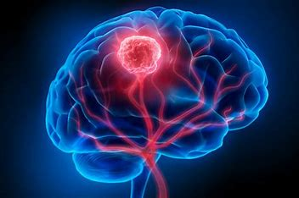
Introduction
Brain tumors represent a serious and potentially life-threatening medical condition that requires early and accurate diagnosis for effective treatment planning. Magnetic Resonance Imaging (MRI) is one of the most widely used imaging modalities for brain tumor diagnosis due to its high soft-tissue contrast and non-invasive nature.

Slide 6
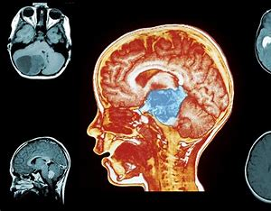
Problem Statement
Manual analysis of brain MRI scans by radiologists is time-consuming, subjective, and prone to inter-observer variability, especially when distinguishing between visually similar tumor types. Additionally, variations in tumor shape, size, and image quality make automated classification challenging. The problem addressed in this work is the development of an accurate and robust deep learning-based system capable of classifying brain MRI images into four classes—glioma, meningioma, pituitary tumor, and no tumor—while handling data variability and minimizing misclassification errors.

Slide 7
Dataset & Preprocessing phase

Slide 8
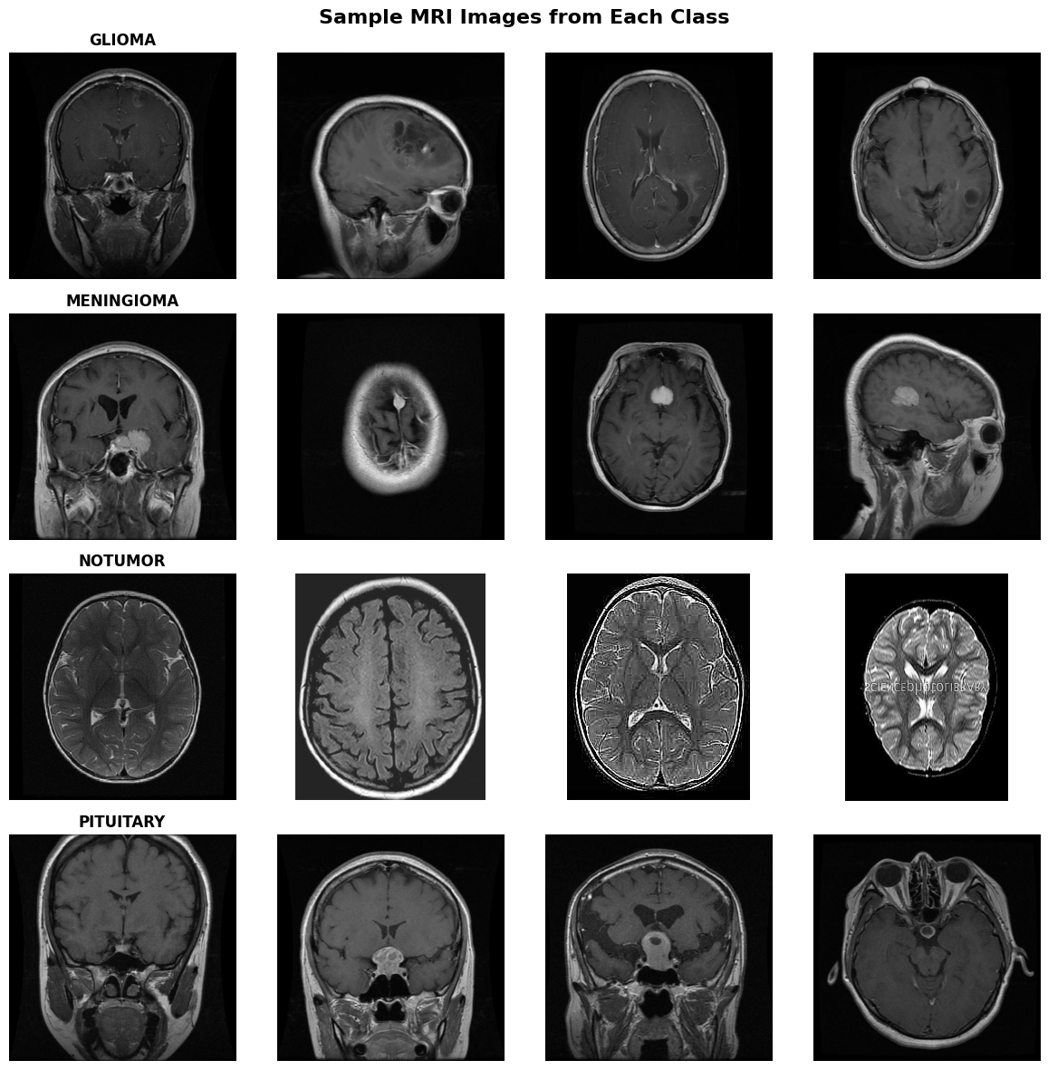
Dataset
Brain Tumor MRI Dataset
Source
Kaggle: Brain Tumor MRI Dataset
Combined from Figshare, SARTAJ, and Br35H
Data Type
MRI brain images (2D)
Classes (Multiclass – 4)
🧠 Glioma
🧠 Meningioma
🧠 Pituitary tumor
✅ No Tumor
Total images
~7,000 MRI scans

Slide 9
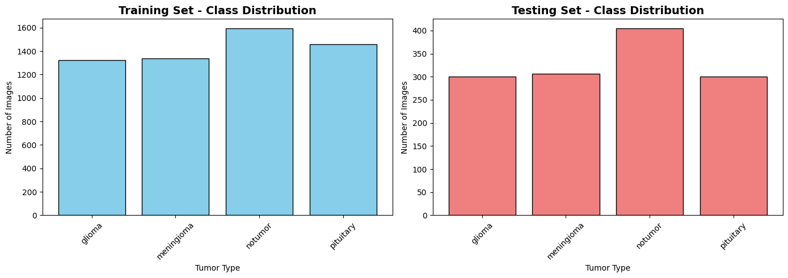
Data Preprocessing
Why augmentation?
Improves generalization on unseen MRI scans
Reduces overfitting
Preprocessing Steps
Image Resizing
Normalization
Data Augmentation (Training only)

Slide 10
ResNet50

Slide 11
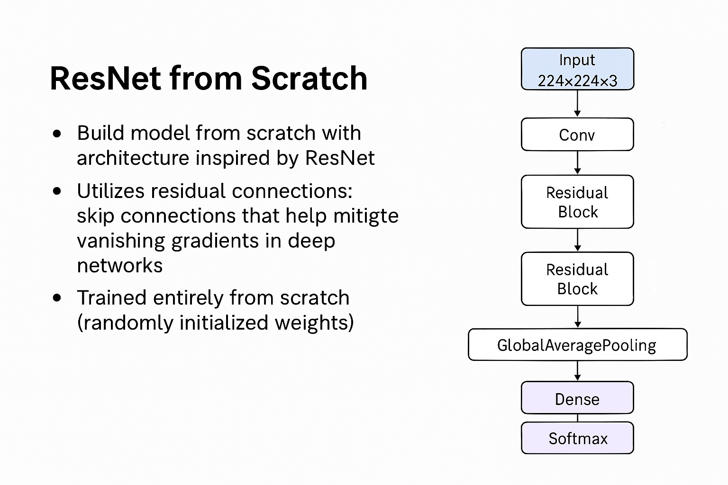
ResNet50

Slide 12

ResNet50 with Transfer Learning
Pre-trained Backbone: ResNet50 (ImageNet weights, include_top=False)
Custom Head:
GlobalAveragePooling2D
BatchNormalization
Dense(512, ReLU) + Dropout(0.5)
Dense(256, ReLU) + Dropout(0.3)
Dense(4, Softmax)
Training Strategy:
Phase 1: Freeze all ResNet50 layers, train custom head
Phase 2: Fine-tune last residual block (conv5_block) with low learning rate
Optimizer: Adam (LR: 1e-4 → 1e-5)
Callbacks: EarlyStopping, ReduceLROnPlateau, ModelCheckpoint

Slide 13
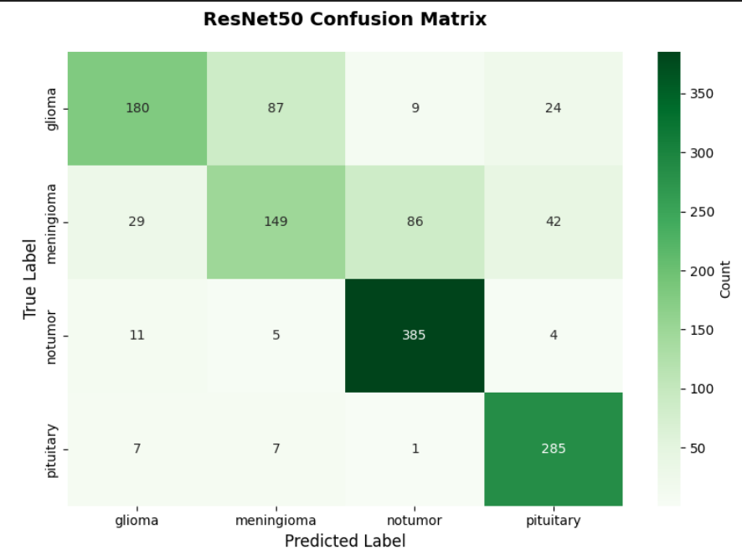
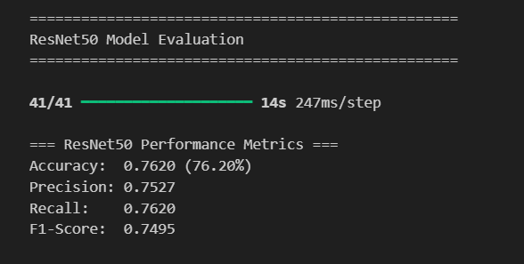
Results (ResNet50)

Slide 14
CNN Model

Slide 15
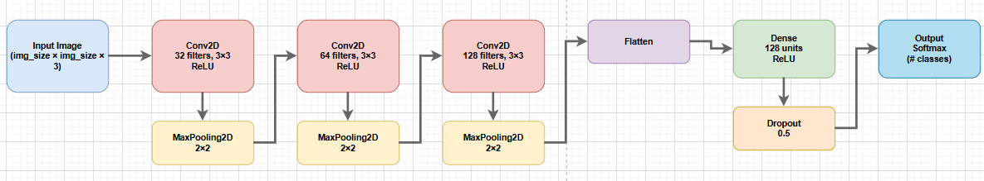
CNN architecture

Slide 16
Training Results
Training accuracy reaches 96%
Validation accuracy reaches 87%
Small gap → slight overfitting
Model learns well over epochs

Slide 17
CNN performs well on image classification
High training accuracy achieved
Acceptable validation performance
Model can be improved with tuning

Slide 18
RESNET 50 Model

Slide 19
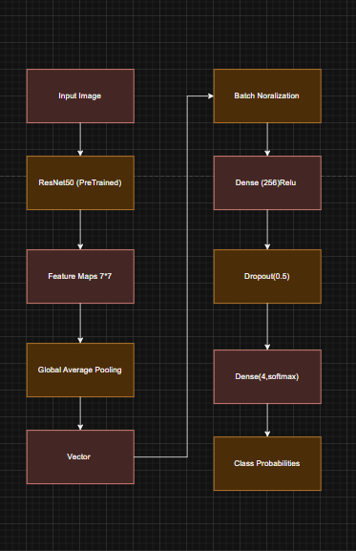
ResNet50
Extracts high-level visual features
GlobalAveragePooling2D
Reduces parameters
BatchNormalization
Stabilizes training
Speeds up convergence
Dense (256, ReLU)
Learns task-specific patterns
Adds non-linearity
Dropout (0.5)
Prevents overfitting
Dense (4, Softmax)
4 output classes
Softmax → probability distribution

Slide 20
Training & Validation Performance:
Training accuracy improved steadily from ~80% to 93.9% over 10 epochs
Validation accuracy increased consistently, reaching 88.87%
Training and validation losses decreased smoothly → indicates stable learning and good convergence
Small gap between training and validation accuracy (~5%) → controlled overfitting due to data augmentation and dropout

Slide 21
Generalization & Final Results:
Test Accuracy: 90.77%
Test performance is higher than validation accuracy → demonstrates strong generalization
Model learned discriminative features without memorizing data
Transfer learning significantly reduced training time and improved accuracy

Slide 22
CNN Model

Slide 23
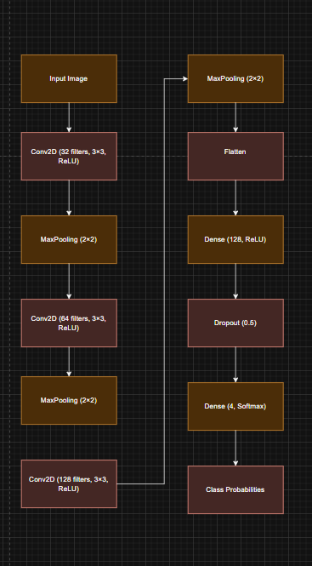
Conv2D (32 filters, 3×3, ReLU)
Learns basic low-level features (edges, corners, simple textures)
MaxPooling2D (2×2)
Reduces spatial size and computation
Conv2D (64 filters, 3×3, ReLU)
Learns more complex patterns
MaxPooling2D (2×2)
Further reduces spatial dimensions
Conv2D (128 filters, 3×3, ReLU)
Extracts high-level visual features
MaxPooling2D (2×2)
Final spatial reduction
Flatten
Converts 3D feature maps into a 1D vector
Dense (128, ReLU)
Introduces non-linearity
Dropout (0.5)
Reduces overfitting
Dense (4, Softmax)
Outputs probabilities for 4 classes

Slide 24
Training vs Validation Behavior:
Training accuracy improved steadily from ~60% to ~82%
Training loss decreased consistently → model successfully fit the training data
Validation accuracy remained very low (~25–36%)
Validation loss increased sharply (up to 8.53)

Slide 25
Generalization Failure & Final Results:
Final Training Accuracy: 81.9%
Final Validation Accuracy: 33.6%
Test Accuracy: 40.66% (very low)
Large gap between training and validation/test performance

Slide 26
Thank You
aya.elhabashy.2023@aiu.edu.eg
rodina.hassan.2023@aiu.edu.eg
rokia.hussien.2023@aiu.edu.eg
negma.fahmy.2023@aiu.edu.eg

